Slide 1
Cryptography

Slide 2
What is cryptography?
Achieving security by encoding messages to make them non-readable.

Slide 3
Key Terms
Plain Text: Human Readable text, understood by both sender as well as receiver and any one else who gets access to the text.
Cipher Text: When plain text message is codified using an algorithm.
Cryptography: Achieving security by encoding messages to make them non-readable.
Cryptoanalysis: techniques of Converting/Decoding messages from cipher text back to plain text
Cryptology: Combination of Cryptography and Cryptoanalysis.

Slide 4
History
The first known evidence=> 1900 BC , tomb of the nobleman Khnumhotep II, in Egypt(was not to hide message, but change hieroglyphic symbols form)
“Arthshashtra” classic work on statecraft written by Kautalya - 300 BC => (espionage service in India and mentions giving assignments to spies in "secret writing" )
Julius Caesar 100BC.
Notes:
https://www.redhat.com/en/blog/brief-history-cryptography

Slide 5
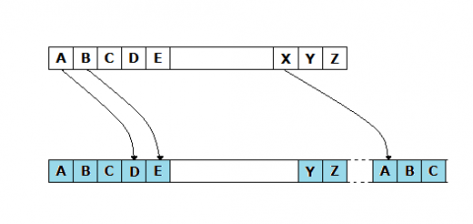
Substitution Cipher
Caesar Cipher
Shift and substitute
Very simple
Can be cracked using frequency analysis

Slide 6
Mono-alphabetic Cipher
Similar to Caesar Cipher,
We use random substitution scheme
Mathematically
4*10²⁶

Slide 7
plain A B C D E F G H I J K L M N O P Q R S T U V W X Y Z
cipher A N D R E W I C K S O H T B F G J L M P Q U V X Y Z

Slide 8
Homophonic Substitution Cipher
The Homophonic Substitution cipher is a substitution cipher in which single plaintext letters can be replaced by any of several different ciphertext letters

Slide 9
Polygram Substitution Cipher
Replace Block of text with cipher text
Example:- Playfair, Hill cipher
Notes:
https://www.geeksforgeeks.org/playfair-cipher-with-examples/
Hill Cipher - GeeksforGeeks

Slide 10
Polyalphabetic Substitution Cipher
Use of one character key
Each of the keys encrypt one plain text character
Vigenère
Bearfort
Variant beaufort

Slide 11
Transportation Techniques
Rail Fence Technique
Simple Columnar Transportation Techniques
Simple columnar Transportation Techniques with multiple rounds

Slide 12
Vernam Cipher (one time pad)
Book Cipher/Running key Cipher

Slide 13
Encryption And Decryption
Encryption :
Decryption:

Slide 14
Cryptographic Techniques
Symmetric key Cryptography
Asymmetric key Cryptography

Slide 15
Need for Asymmetric key Cryptography
Problem of key distribution

Slide 16
Diffle Hellman Key Exchange algorithm.
1) Both the parties select very big prime numbers.
G and n
Once the G and n is selected both person1 and person2 will select secrets x and y.
Once x and y is selected, A and B will calculated.
A and B will be shared with respected parties.
Both the people will then calculate k1 and k2.

Slide 17
Working of algorithm
G , n => Very large prime; x, y=> randomly selected values.
A = G^{x} mod n => will be calculated by person 1
B = G^{y} mod n => will be calculated by person 2
A will be sent to person1 and B will be sent to person2
K1 = B^{x} mod n
K2 = A^{y} mod n

Slide 18
A=G^{x} mod n
Alice
Bob
B=G^{y} mod n

Slide 19
Man in the middle attack
Gaining access to data by falsifying key data sent between two parties.
Process:
Select two random numbers. X1, Y1.
Intercept A calculate A1 using X1, send A1 to receiver
Intercet B calculate B1 using Y1, send B1 to sender.
Notes:
https://www.imperva.com/learn/application-security/man-in-the-middle-attack-mitm/
https://www.geeksforgeeks.org/man-in-the-middle-attack-in-diffie-hellman-key-exchange/

Slide 20
Alice
Bob
A1=G^{x1} mod n
B1=G^{y1} mod n
A=G^{x} mod n
B=G^{y} mod n
Candice

Slide 21
Symmetric Encryption
Block Cipher
Digital Encryption Standard (DES)
Triple DES
Advanced Encryption Standard (AES)

Slide 22



Key
Data
Cipher Text

Slide 23

Fiestal Cipher
Round
Data
Key
Left
Right
f(x)
Key1
XOR
Left1
Right1

Slide 24
Block Cipher
Data
DataBlock 1
DataBlock 2
Key
Key
Cipher Text
Cipher Text

Slide 25
DES
Data Encryption Standard
Notes:
https://www.tutorialspoint.com/cryptography/data_encryption_standard.htm
https://en.wikipedia.org/wiki/DES_supplementary_material

Slide 26
64 Bit Data
Initial Permutation(IP) 64 Bit
LPT 32 bit
RPT 32 bit
KEY
16 Rounds
16 Rounds
Final Permutation(IP) 64 Bit
64 Bit Cipher Text

Slide 27
Key Generation for Round
Key (64Bit)
28 bits
28 bits
Parity Drop (56 bit)
Left Side
28 bit
Left Side
28 bit
ShiftLeft()
28 bits
28 bits
Shift()
56 bits
Compressor function
Converts 56 bit key to 48 bit
48 bits Round Key
Left Side
28 bit
Left Side
28 bit
Shift()
Shift()
Shift: Works by Shifting left by certain number in different Rounds. 1,2,9,16 shift by 1, other shift by 2.

Slide 28
Parity Drop: Drop every 8th bit of the key
Split the resulting key in two halves
Shift left the resulting 28 bit halves according to the rounds
Combine both keys to get a resulting 58 bit key.
Compression Permutation: The Resulting key after left shifts will be input to this function. Where the key is transposed according to a pattern, and bits at position 9,18,22,25,35,43 and 54 are dropper

Slide 29
Compression Permutation Patter
 | 1 | 2 | 3 | 4 | 5 | 6 | 7 | 8
1 | 14 | 17 | 11 | 24 | 1 | 5 | 3 | 28
2 | 15 | 6 | 21 | 10 | 23 | 19 | 12 | 4
3 | 26 | 8 | 16 | 7 | 27 | 20 | 13 | 2
4 | 41 | 52 | 31 | 37 | 47 | 55 | 30 | 40
5 | 51 | 45 | 33 | 48 | 44 | 49 | 39 | 56
6 | 34 | 53 | 46 | 42 | 50 | 36 | 29 | 32

Slide 30
How Round function Work
In
Expansion Permutation
Convert 32 to 48
Round Key(48 Bit)
S-Box
Converts 48 to 32 bit
P-Box
out

Slide 31
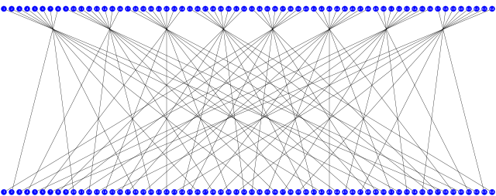
Initial Permutation (IP)
Initial Permutation Swaps the Place of every bit in the data, corresponding to the following table.
58 | 50 | 42 | 34 | 26 | 18 | 10 | 2
60 | 52 | 44 | 36 | 28 | 20 | 12 | 4
62 | 54 | 46 | 38 | 30 | 22 | 14 | 6
64 | 56 | 48 | 40 | 32 | 24 | 16 | 8
57 | 49 | 41 | 33 | 25 | 17 | 9 | 1
59 | 51 | 43 | 35 | 27 | 19 | 11 | 3
61 | 53 | 45 | 37 | 29 | 21 | 13 | 5
63 | 55 | 47 | 39 | 31 | 23 | 15 | 7

Slide 32
Split
58 | 50 | 42 | 34
60 | 52 | 44 | 36
62 | 54 | 46 | 38
64 | 56 | 48 | 40
57 | 49 | 41 | 33
59 | 51 | 43 | 35
61 | 53 | 45 | 37
63 | 55 | 47 | 39
26 | 18 | 10 | 2
28 | 20 | 12 | 4
30 | 22 | 14 | 6
32 | 24 | 16 | 8
25 | 17 | 9 | 1
27 | 19 | 11 | 3
29 | 21 | 13 | 5
31 | 23 | 15 | 7
LPT
RPT

Slide 33
Expansion Permutation
LPT (32 bit)
Resulting LPT (48 bit)

Slide 34
XOR
Resulting LPT (48 bit)
Round key (48 bit)
XOR data (48 bit)

Slide 35
S-Box (Expansion Permutation)
S₁ | x0000x | x0001x | x0010x | x0011x | x0100x | x0101x | x0110x | x0111x | x1000x | x1001x | x1010x | x1011x | x1100x | x1101x | x1110x | x1111x
0yyyy0 | 14 | 4 | 13 | 1 | 2 | 15 | 11 | 8 | 3 | 10 | 6 | 12 | 5 | 9 | 0 | 7
0yyyy1 | 0 | 15 | 7 | 4 | 14 | 2 | 13 | 1 | 10 | 6 | 12 | 11 | 9 | 5 | 3 | 8
1yyyy0 | 4 | 1 | 14 | 8 | 13 | 6 | 2 | 11 | 15 | 12 | 9 | 7 | 3 | 10 | 5 | 0
1yyyy1 | 15 | 12 | 8 | 2 | 4 | 9 | 1 | 7 | 5 | 11 | 3 | 14 | 10 | 0 | 6 | 13

Slide 36
P-Box
Left
Right
57 | 49 | 41 | 33 | 25 | 17 | 9
1 | 58 | 50 | 42 | 34 | 26 | 18
10 | 2 | 59 | 51 | 43 | 35 | 27
19 | 11 | 3 | 60 | 52 | 44 | 36
63 | 55 | 47 | 39 | 31 | 23 | 15
7 | 62 | 54 | 46 | 38 | 30 | 22
14 | 6 | 61 | 53 | 45 | 37 | 29
21 | 13 | 5 | 28 | 20 | 12 | 4

Slide 37
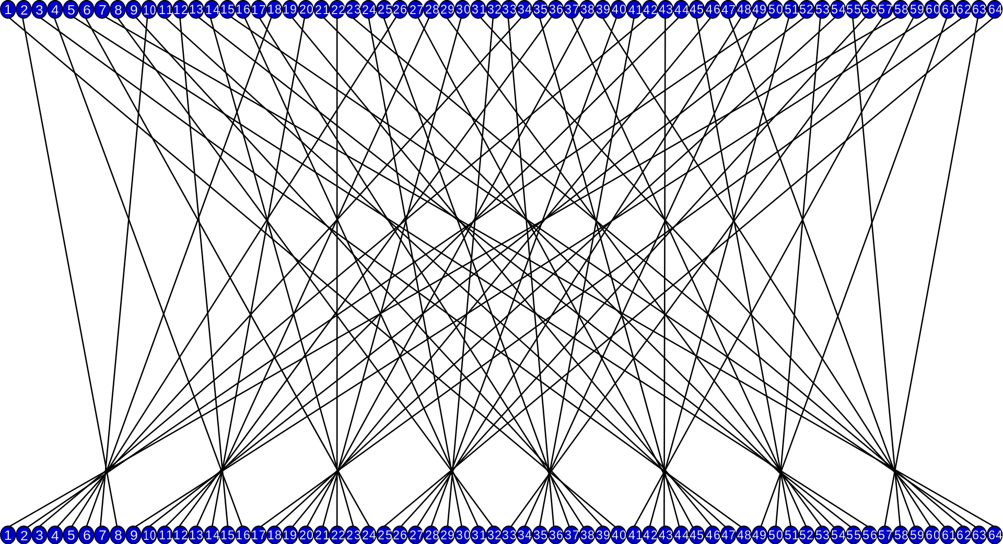
Final Permutation (Ip⁻¹)
40 | 8 | 48 | 16 | 56 | 24 | 64 | 32
39 | 7 | 47 | 15 | 55 | 23 | 63 | 31
38 | 6 | 46 | 14 | 54 | 22 | 62 | 30
37 | 5 | 45 | 13 | 53 | 21 | 61 | 29
36 | 4 | 44 | 12 | 52 | 20 | 60 | 28
35 | 3 | 43 | 11 | 51 | 19 | 59 | 27
34 | 2 | 42 | 10 | 50 | 18 | 58 | 26
33 | 1 | 41 | 9 | 49 | 17 | 57 | 25

Slide 38
Exhaustive key searches
Exhaustive key search, or brute-force search, is the basic technique of trying every possible key in turn until the correct key is identified

Slide 39
3 DES

Slide 40
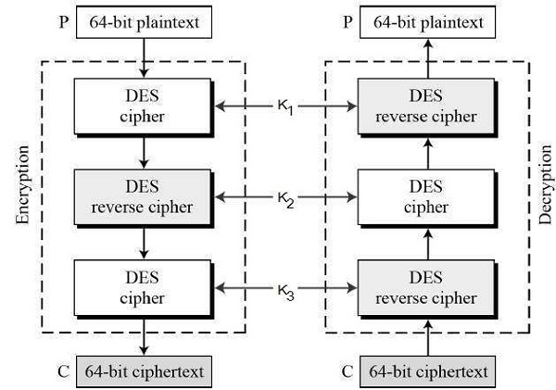
Using 3 keys

Slide 41
1

Slide 42
AES

Slide 43
Overall
Key
Plain Text
K0
Sub Bytes
Sub Bytes
Mix Columns
K1
Add Round Key
Note : Mix Columns is not used in round as its not useful
Notes:
https://www.youtube.com/watch?v=O4xNJsjtN6E&t=135s
https://www.techtarget.com/searchsecurity/definition/Rijndael

Slide 44
Finite Field Operations
Notes:
https://www.youtube.com/watch?v=9TYfiO__m2A

